Slide 1

Chapter 2 – part II

Slide 2
OUTLINE
  Free fall.
  Motion with changing acceleration.
  Problems.

Slide 3
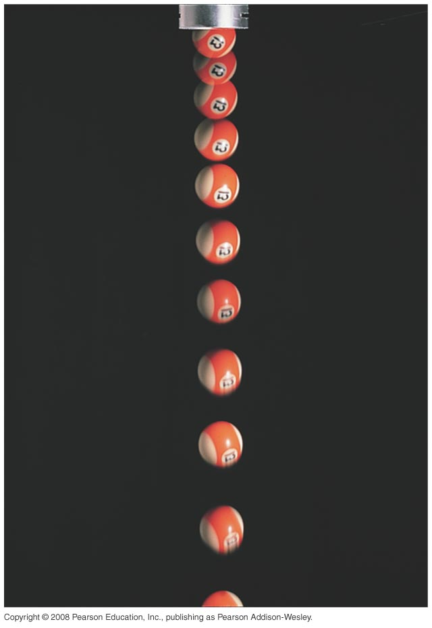
Freely falling bodies
Free fall is the motion of an object under the influence of only gravity.
In the figure, a strobe light flashes with equal time intervals between flashes.
The velocity change is the same in each time interval, so the acceleration is constant.

Slide 4
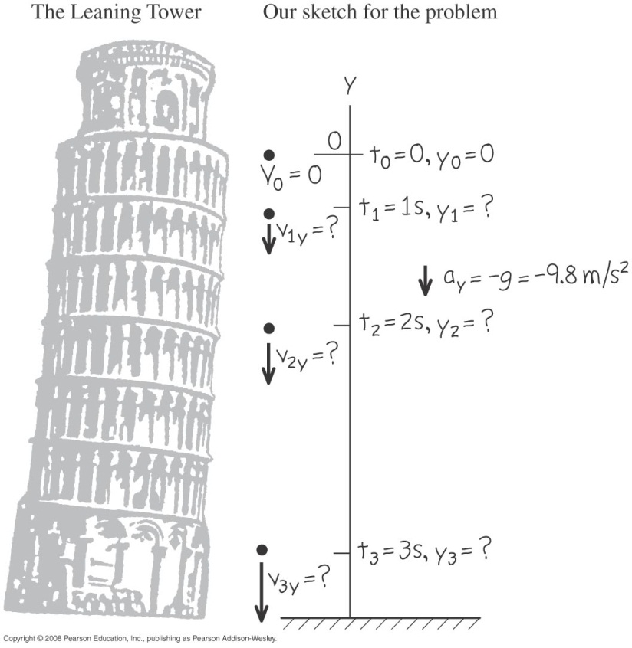
A freely falling coin
  Aristotle thought that heavy bodies fall faster than light ones, but Galileo showed that all bodies fall at the same rate.
  If there is no air resistance, the downward acceleration of any freely falling object is g = 9.8 m/s² = 32 ft/s².

Slide 5
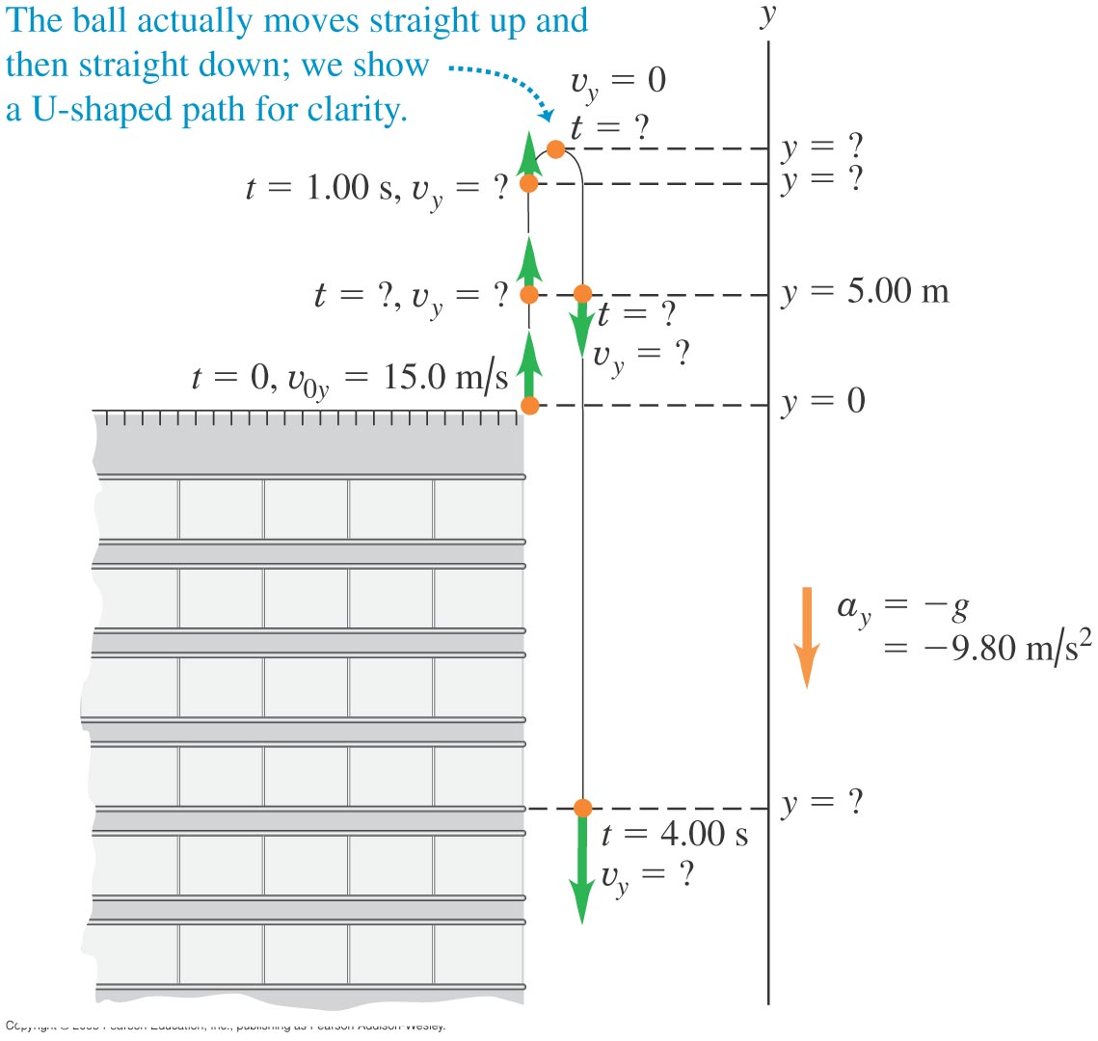
Up-and-down motion in free fall
An object is in free fall even when it is moving upward.

Slide 6
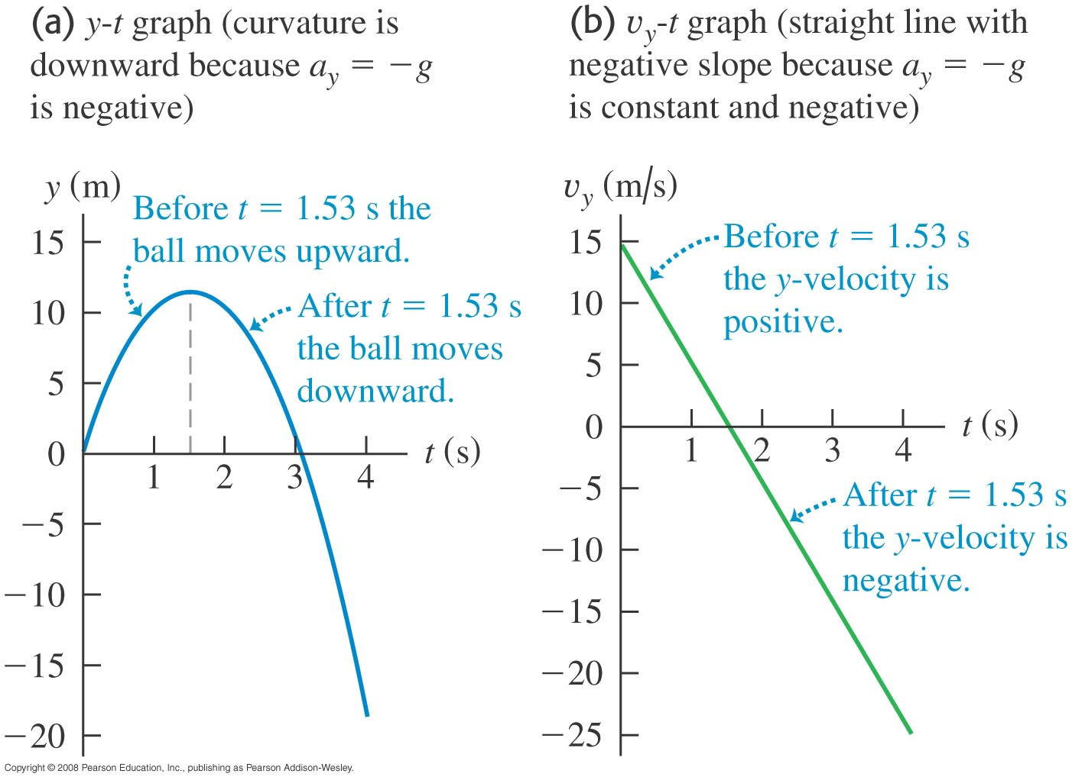
acceleration at the highest point
  The vertical velocity, but not the acceleration, is zero at the highest point.

Slide 7
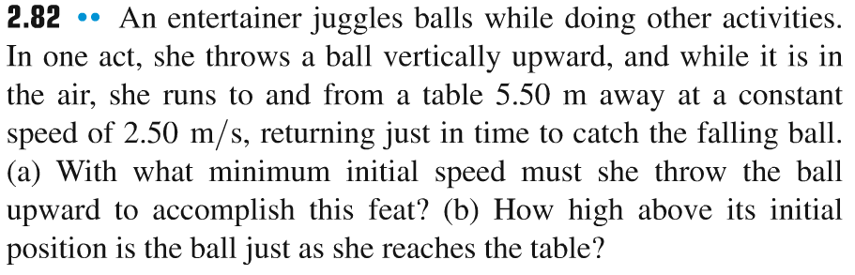
Problem #1

Slide 8
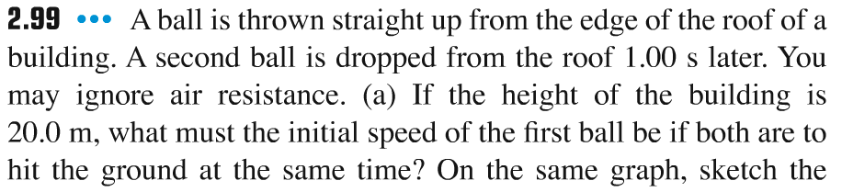
Problem #2

Slide 9

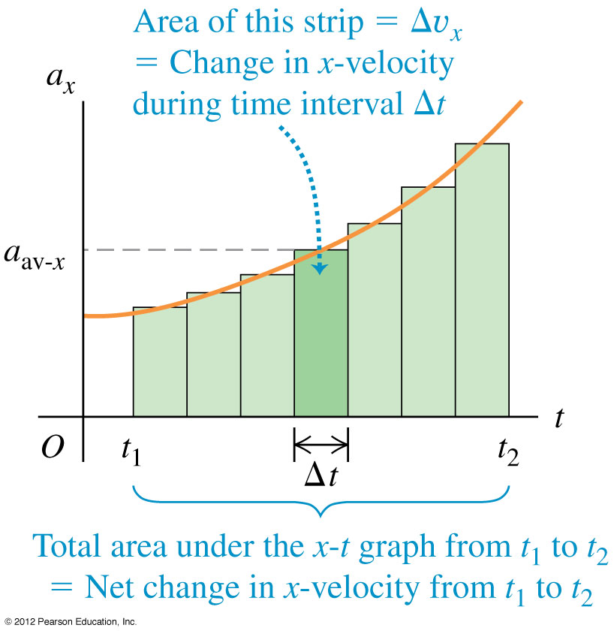
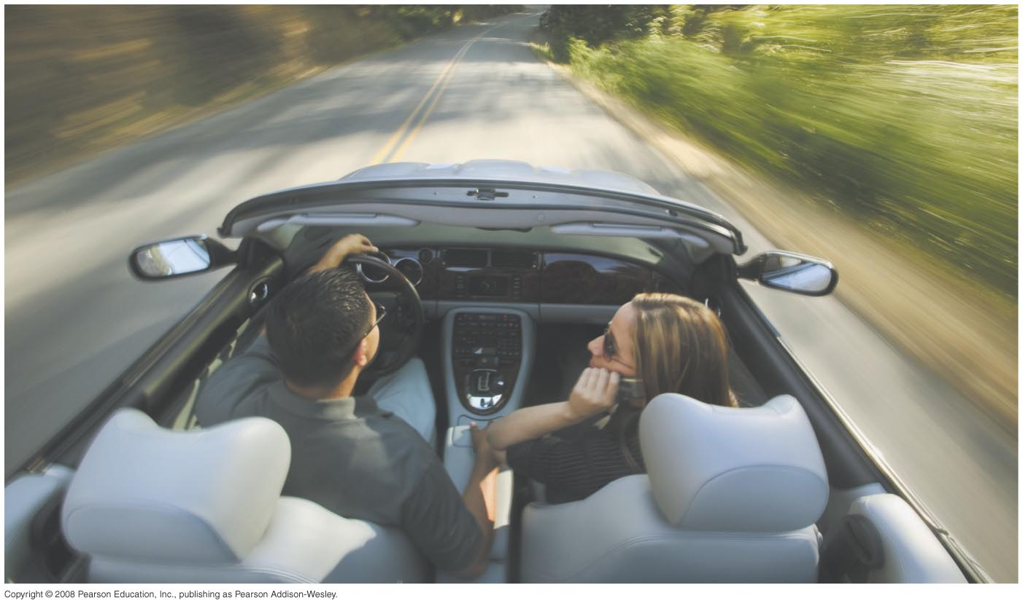
Velocity and position by integration
  The acceleration of a car is not always constant.
  The motion may be integrated over many small time intervals to give

Slide 10
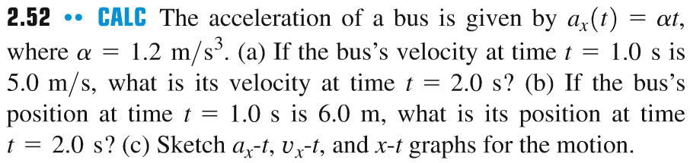
Problem #3

Slide 11
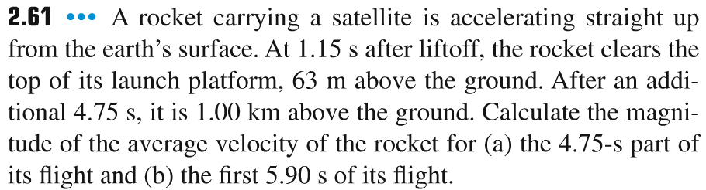
Problem #4

Slide 12
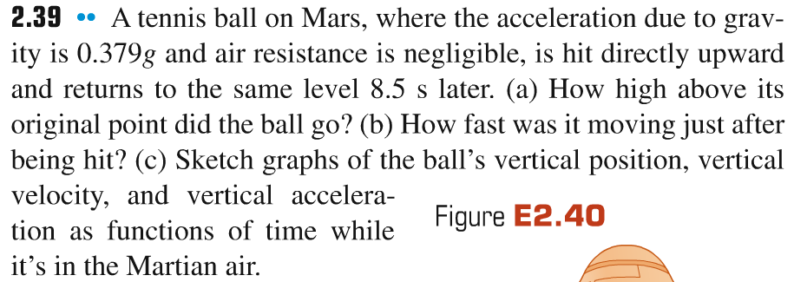
Problem #5

